Slide 1

Instagram User Analytics
Presented By : Rahul Vishwakarma

Slide 2
Company Overview
My role involves analyzing user interactions and engagement with the Instagram app to provide valuable insights that can help the business grow.
User analysis involves tracking how users engage with a digital product, such as a software application or a mobile app. The insights derived from this analysis can be used by various teams within the business.
The marketing team might use these insights to launch a new campaign, the product team might use them to decide on new features to build, and the development team might use them to improve the overall user experience.

Slide 3
Marketing Analysis

Slide 4
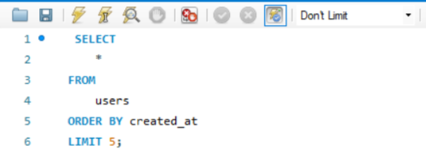

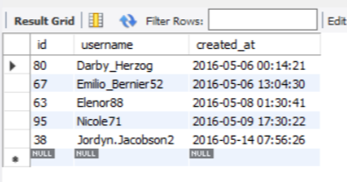
The marketing team wants to reward the most loyal users, i.e., those who have been using the platform for the longest time.
Loyal User Reward
Identify the five oldest users on Instagram from the provided database.
SELECT
*
FROM
users
ORDER BY created_at
LIMIT 5;

Slide 5
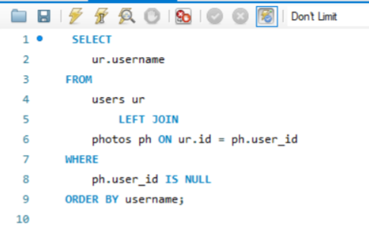

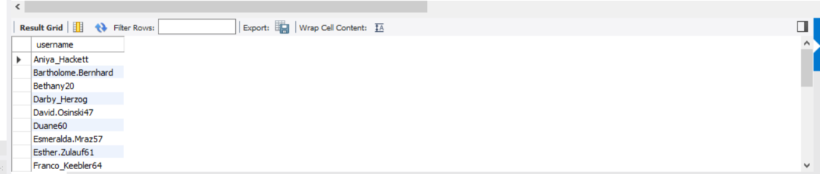
Identify users who have never posted a single photo on Instagram.
Inactive User Engagement
The team wants to encourage inactive users to start posting by sending them promotional emails.
SELECT
ur.username
FROM
users ur
LEFT JOIN
photos ph ON ur.id = ph.user_id
WHERE
ph.user_id IS NULL
ORDER BY username;

Slide 6
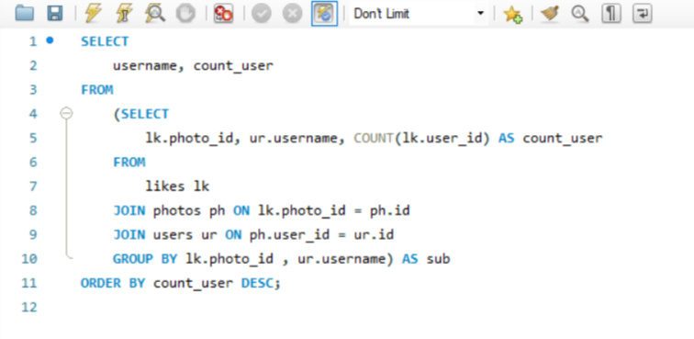

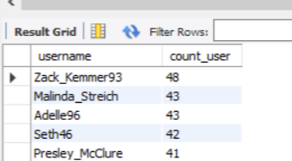
The team has organized a contest where the user with the most likes on a single photo wins.
Contest Winner Declaration
Determine the winner of the contest and provide their details to the team.
SELECT username ,count_user
FROM (
SELECT
lk.photo_id,
ur.username,
COUNT(lk.user_id) AS count_user
FROM likes lk
JOIN photos ph ON lk.photo_id = ph.id
JOIN users ur ON ph.user_id = ur.id
GROUP BY lk.photo_id, ur.username
) AS sub
ORDER BY count_user DESC;

Slide 7
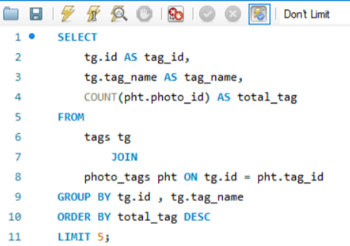

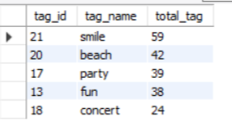
A partner brand wants to know the most popular hashtags to use in their posts to reach the most people.
Hashtag Research
Identify and suggest the top five most commonly used hashtags on the platform.
SELECT
tg.id AS tag_id,
tg.tag_name AS tag_name,
COUNT(pht.photo_id) AS total_tag
FROM
tags tg
JOIN
photo_tags pht ON tg.id = pht.tag_id
GROUP BY tg.id , tg.tag_name
ORDER BY total_tag DESC
LIMIT 5;

Slide 8
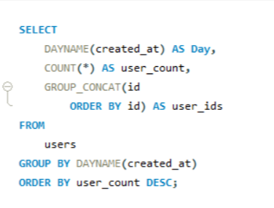
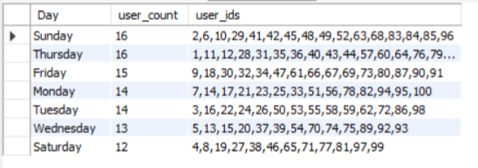
The team wants to know the best day of the week to launch ads.
Ad Campaign Launch
Determine the day of the week when most users register on Instagram. Provide insights on when to schedule an ad campaign.
SELECT
DAYNAME(created_at) AS Day,
COUNT(*) AS user_count,
GROUP_CONCAT(id
ORDER BY id) AS user_ids
FROM
users
GROUP BY DAYNAME(created_at)
ORDER BY user_count DESC;

Slide 9
Investor Metrics

Slide 10
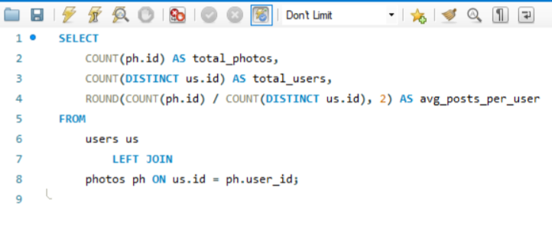
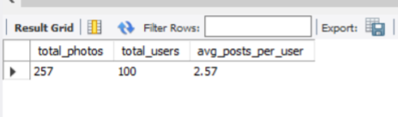
Investors want to know if users are still active and posting on Instagram or if they are making fewer posts.
User Engagement
Calculate the average number of posts per user on Instagram.
SELECT
COUNT(ph.id) AS total_photos,
COUNT(DISTINCT us.id) AS total_users,
ROUND(COUNT(ph.id) / COUNT(DISTINCT us.id), 2) AS avg_posts_per_user
FROM
users us
LEFT JOIN
photos ph ON us.id = ph.user_id;

Slide 11
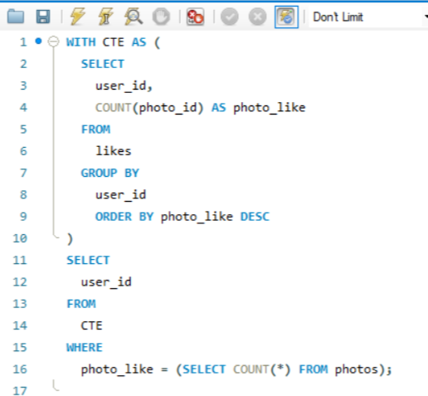

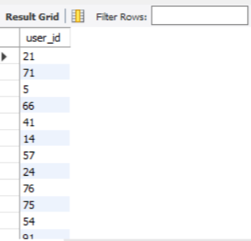
Investors want to know if the platform is crowded with fake and dummy accounts.
Bots & Fake Accounts
Calculate the average number of posts per user on Instagram.
WITH CTE AS (
SELECT
user_id,
COUNT(photo_id) AS photo_like
FROM
likes
GROUP BY
user_id
ORDER BY photo_like DESC
)
SELECT
user_id
FROM
CTE
WHERE
photo_like = (SELECT COUNT(*) FROM photos);

Slide 12
Thank You

